Slide 1
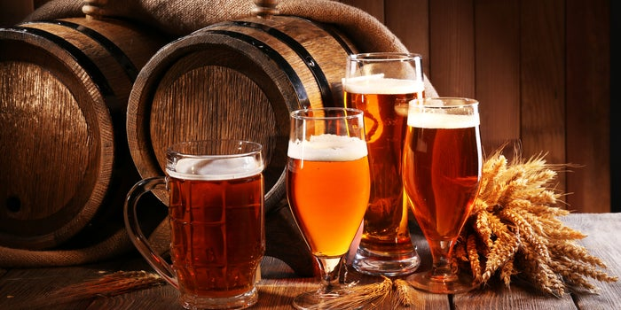
Beers & Breweries
Case study 1: Presented by Shiju Raju & Roger Tchegui
MSDS 6306 Doing Data Science
Summer 2021

Slide 2
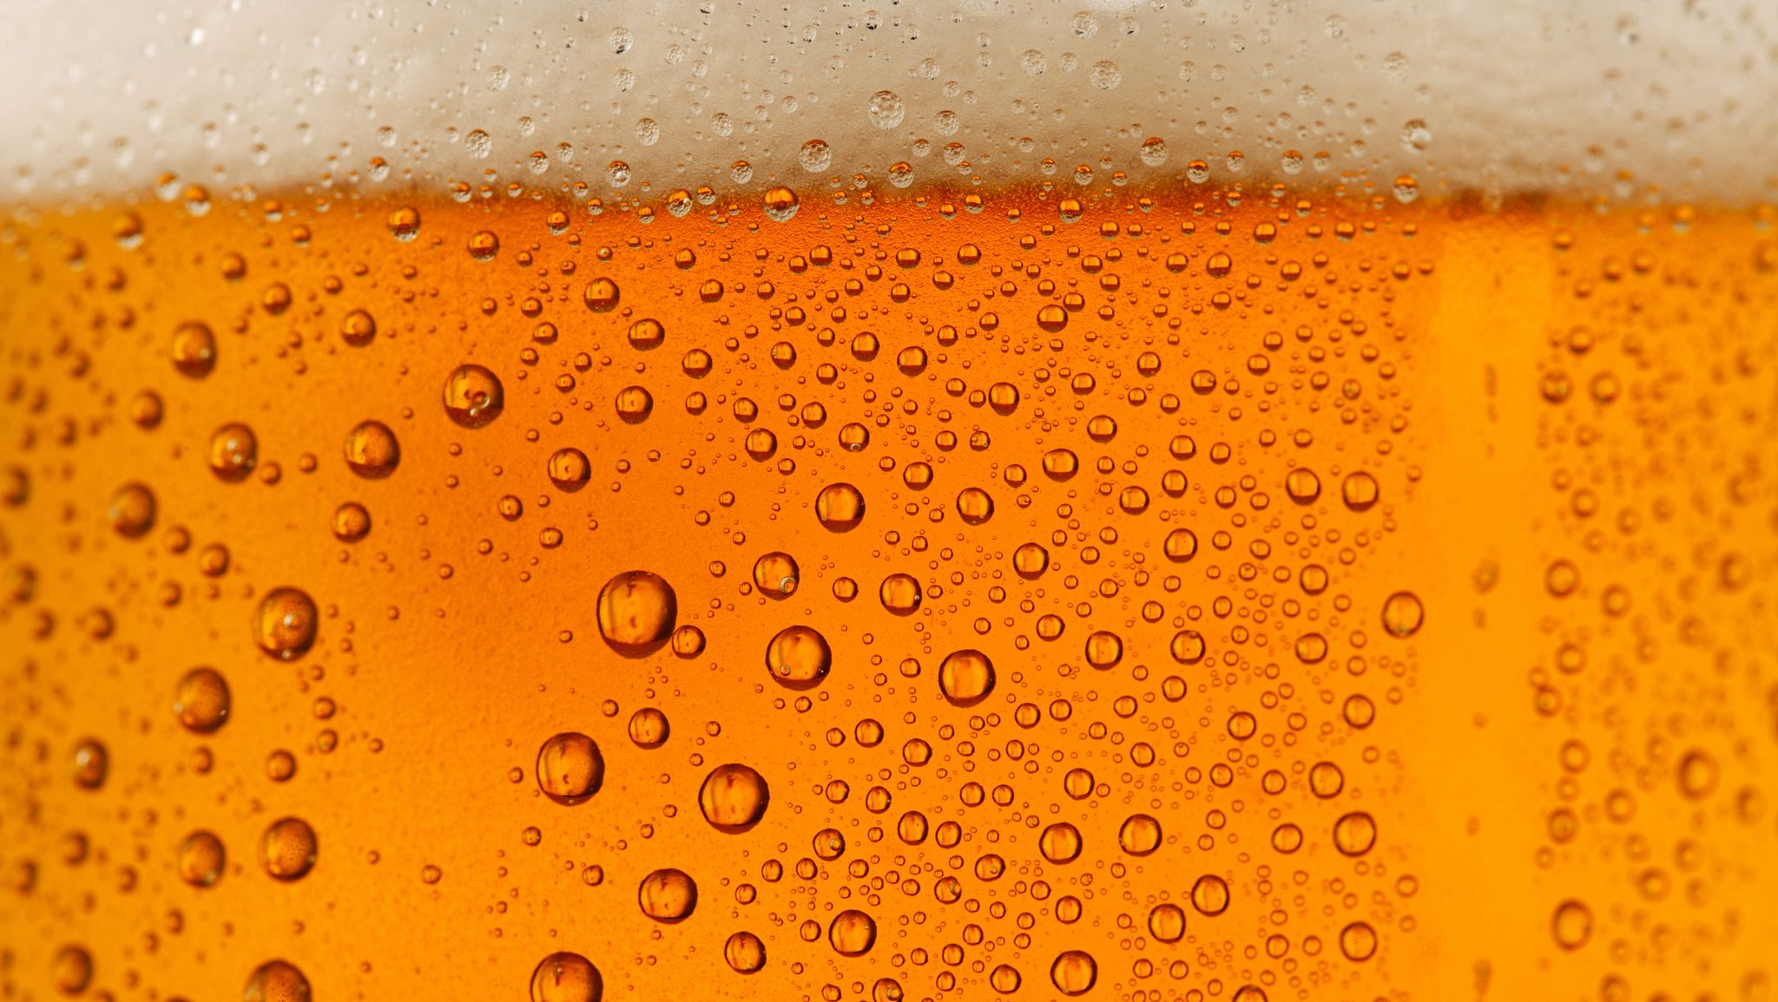
INTRODUCTION
This case study ties 2 data sets together about breweries and the beer they make. From the brewery & beer merged data, we look at the bitterness (IBU) and alcohol by volume (ABV) in relation to their brewery state. We then will look further into the relationship between IBU and ABV and see if there is a correlation.
OBJECTIVE
Analyze the datasets and answer the customer request.
Gain additional insights that is value-added to the customer.

Slide 3

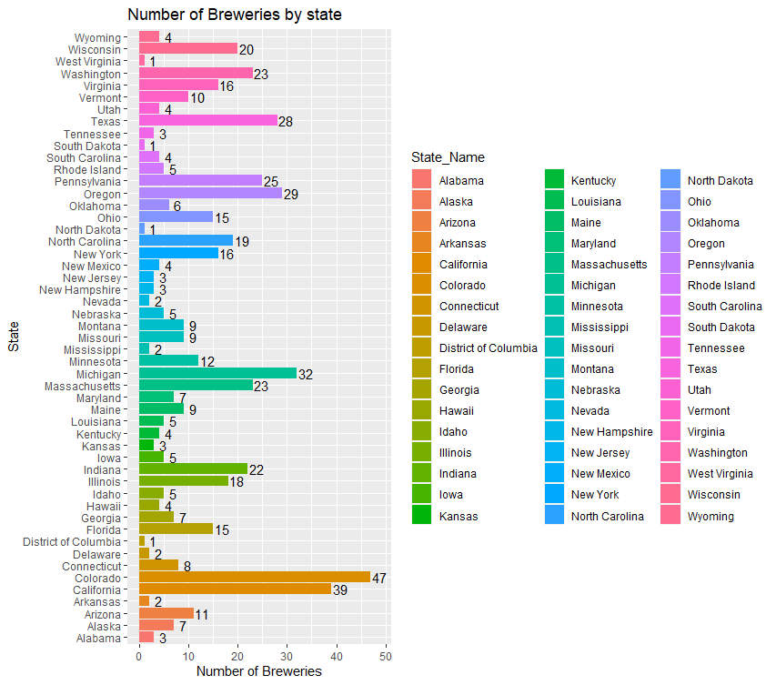
1. BREWERIES IN EACH STATE

Slide 4
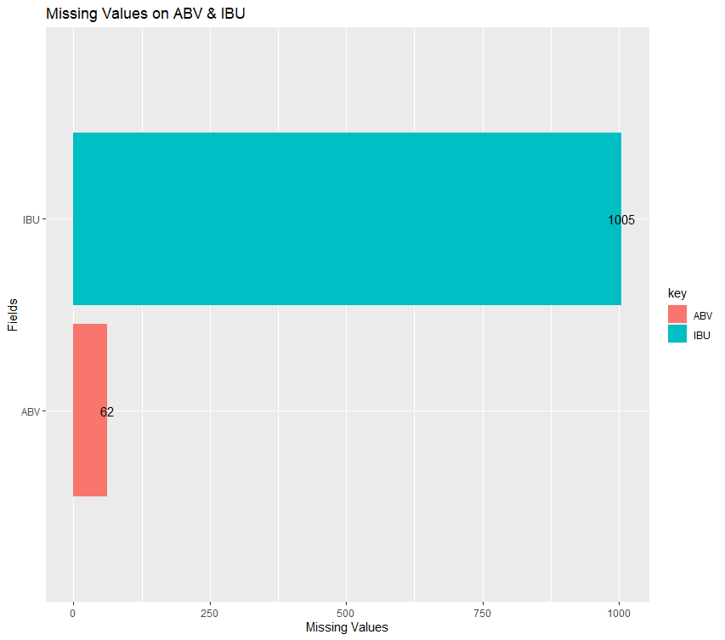

3. MISSING VALUES-BEERS DATA SET

Slide 5
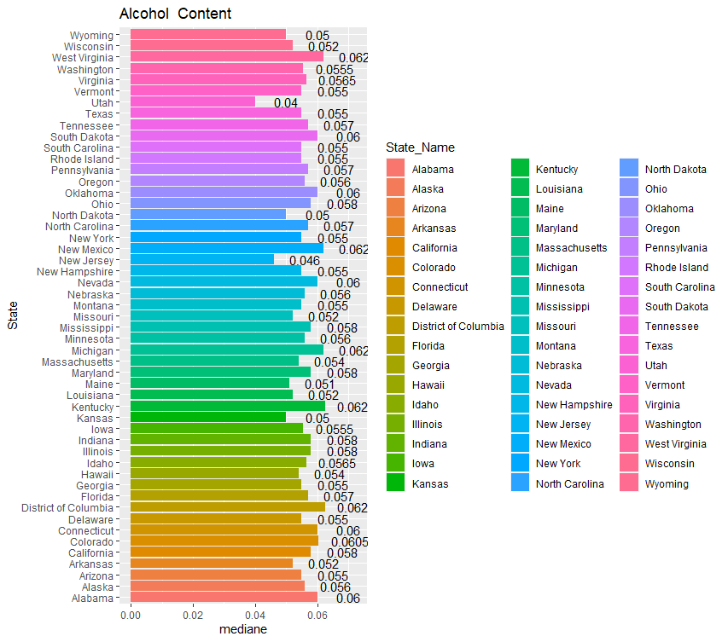
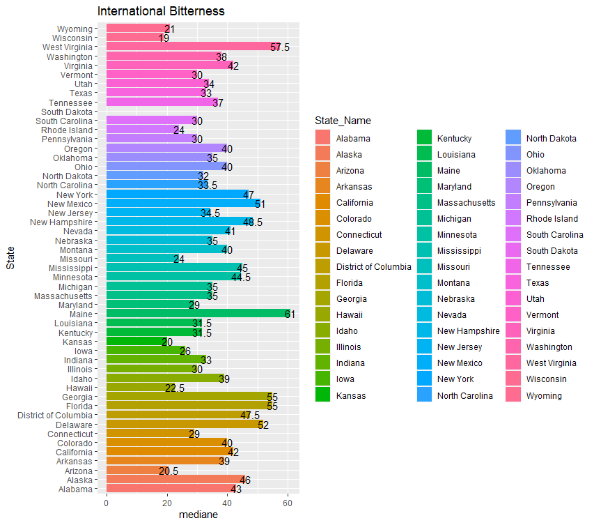
4. MEDIAN ABV & IBU FOR EACH STATE
UPDATE THIS CHART!!

Slide 6
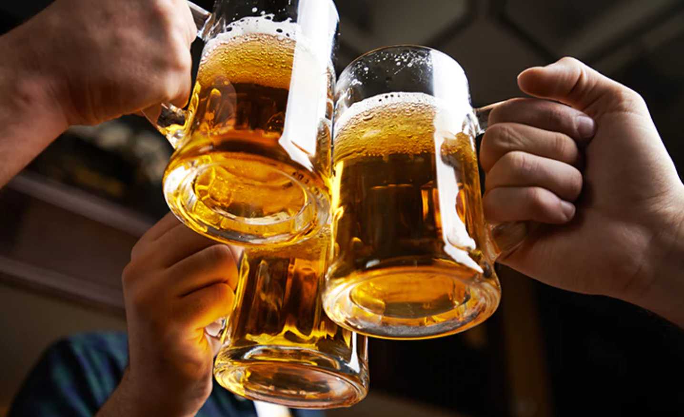
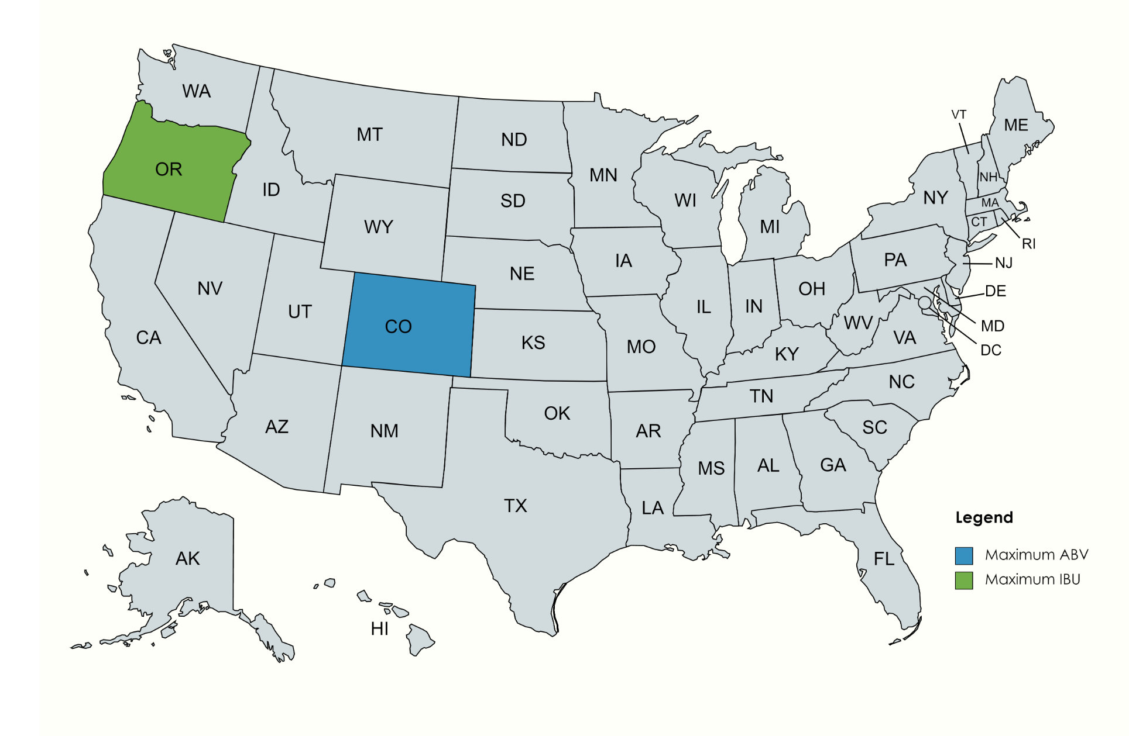
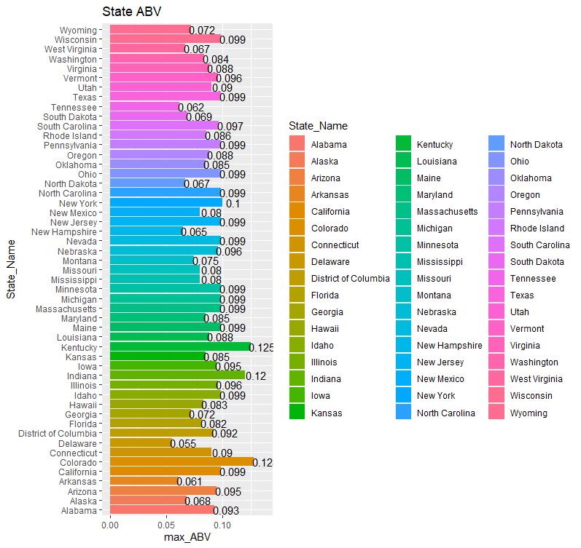
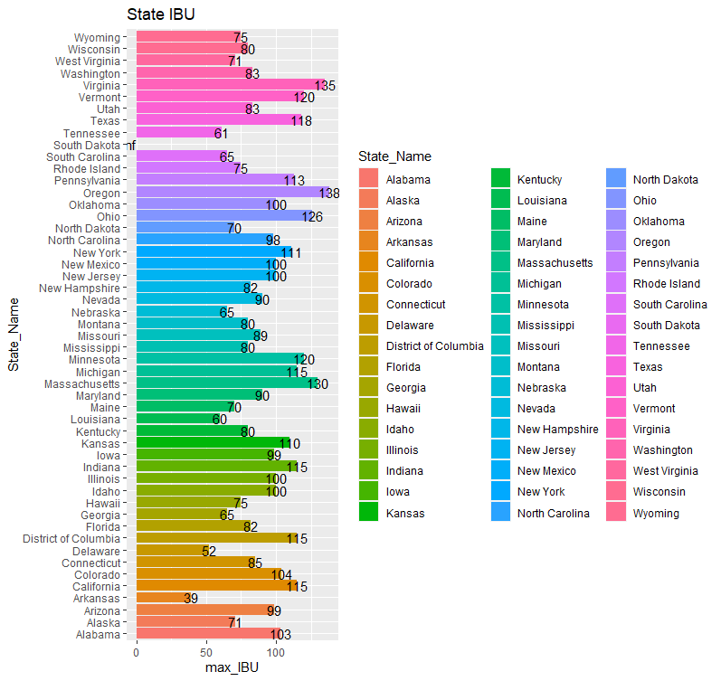
5. Max ABV & IBU

Slide 7
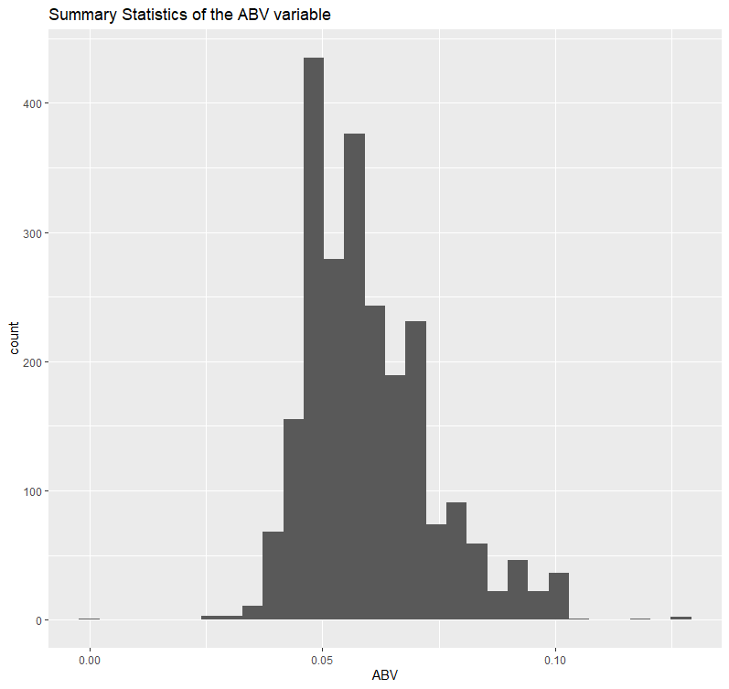

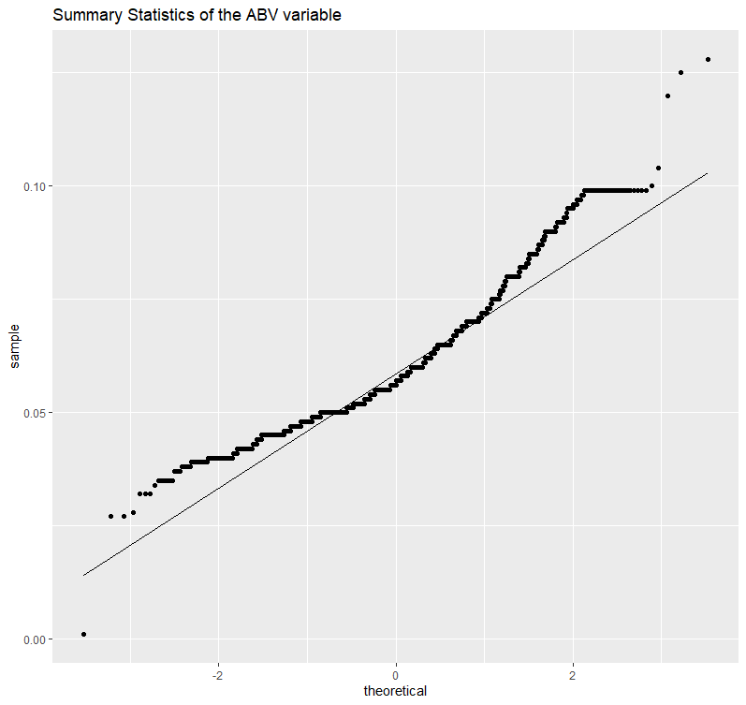
6.Summary-Statistics & ABV distribution

Slide 8
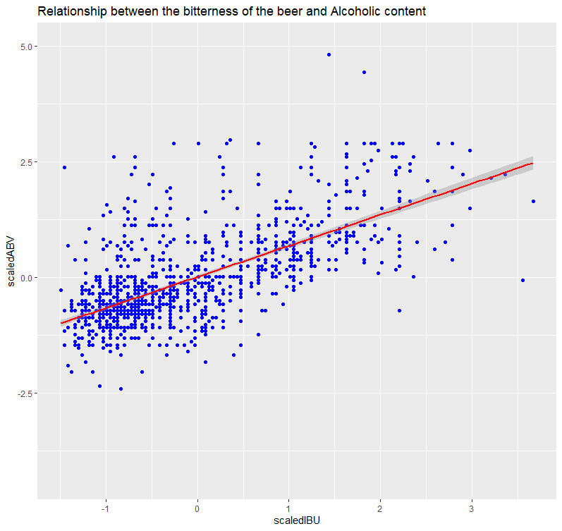
7. Relationship between IBU and ABV.
Add a linear regression line here

Slide 9
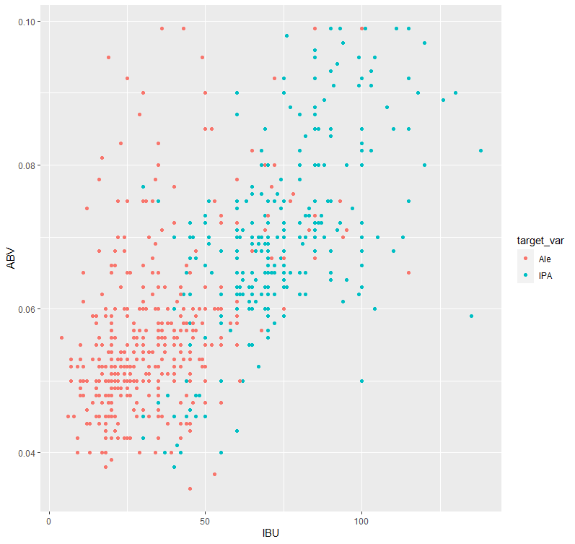
8. Budweiser would also like to investigate the difference with respect to IBU and ABV between IPAs (India Pale Ales) and other types of Ale (any beer with “Ale” in its name other than IPA). You decide to use KNN classification to investigate this relationship. Provide statistical evidence one way or the other. You can of course assume your audience is comfortable with percentages … KNN is very easy to understand conceptually.

Slide 10
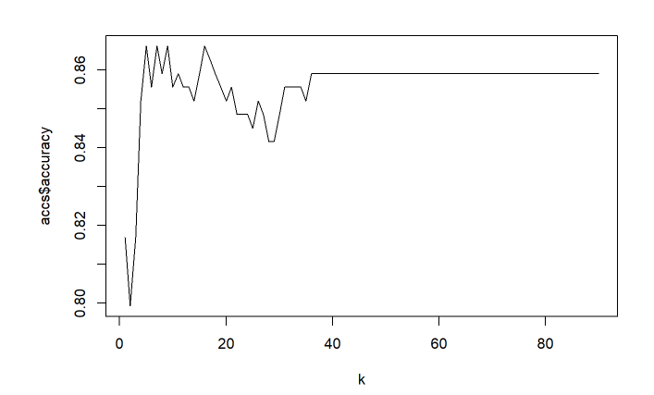
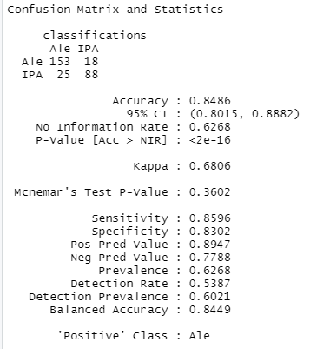

In addition, while you have decided to use KNN to investigate this relationship (KNN is required) you may also feel free to supplement your response to this question with any other methods or techniques you have learned. Creativity and alternative solutions are always encouraged.

Slide 11
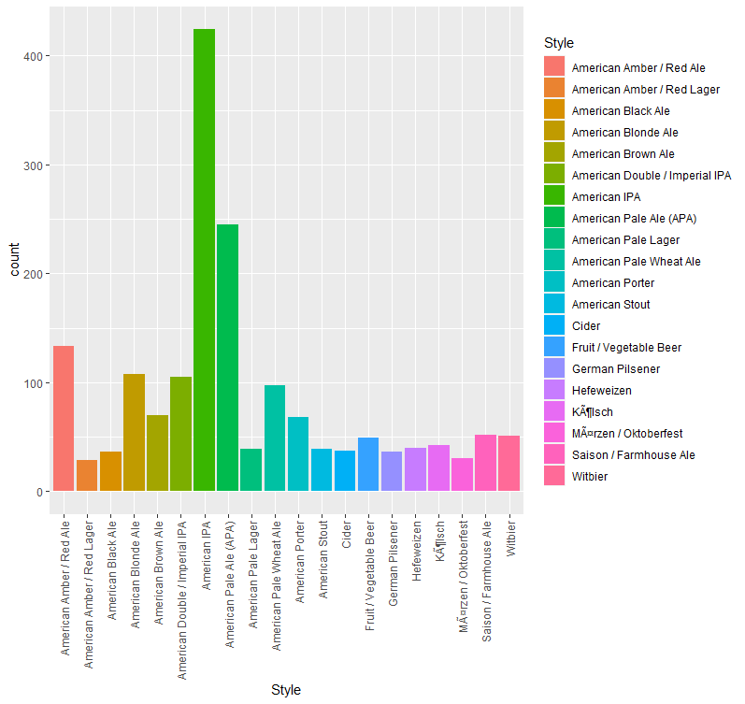
9. Knock their socks off! Find one other useful inference from the data that you feel Budweiser may be able to find value in. You must convince them why it is important and back up your conviction with appropriate statistical evidence.

Slide 12
CONCLUSION
With a p value of 2.2e-16 we can say we should reject the null hypothesis that the intercept is 0 which is further proved by the confidence interval being .8015 to .8882 at 95%. It’s safe to say that as you increase either ABV or IBU the other will increase as well.
It’s also worth noting that 1005 beers out of 2410 do not have an IBU value, but there is still 1405 observations with IBU which is a large sample still.
The scatter plot of our beers style show high concentration of ABV and IBU, IPA beers Style
The KNN model of our data show a high accuracy for a K value between 2 and 5 . Additional finding also show a high consummation of America IPA style meaning that it will probably be beneficial for the customer more of this style of beer in other to generate more profits.

